Slide 1
Descriptive Feedback, Learning Journals, and SeeSaw
- the Learning App
http://bit.ly/2orCcX2
Facilitating student self reflection, fostering meaningful peer feedback, and genuine discussion among peers through use of the SeeSaw App.
PRESENTER: EMILY SCHOLFIELD

Slide 2
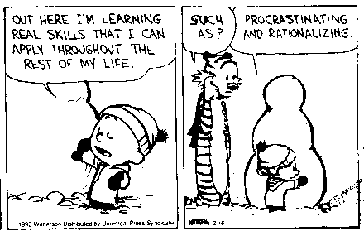
...DEEP LEARNING
… aaand now for something COMPLETELY different...

Slide 3
How are SeeSaw Learning Journals and Descriptive Feedback going to improve DEEP LEARNING in your class?
(...other than making your life easier???)

Slide 4
MEANINGFUL & DESCRIPTIVE FEEDBACK
FACT: Students do not know how to constructively criticize others work.
FACT: Students often have difficulty criticizing their own work and recognising their own learning.
FACT: most students think is constructive criticism.
JACK HANDY

Slide 5
HOW CAN YOU INTRODUCE THE VALUE OF MEANINGFUL FEEDBACK?
THE STORY OF AUSTIN’S BUTTERFLY:
ACCESSIBLE to all ages (young ones can identify with it, and the older students aren’t threatened by it, and think it’s cute)
Opens the DIALOGUE about what kind of feedback is meaningful and descriptive
Gives tangible results that INSPIRES solid comments
Supports GROWTH MINDSET and the importance of revision and reflection

Slide 6
BREAKING IT DOWN:HAND OUT
GIVING MEANINGFUL PEER FEEDBACK
WHY GIVE DESCRIPTIVE FEEDBACK...OR ANY AT ALL?
Descriptive feedback allows you to help each other see your work more critically, and can provides visible and manageable ‘next steps’. Feedback in the form of grades or brief general comments, (e.g., <3, “like”, it’s good ) provides empty information about the work and does not give any real direction that can be used to improve.
LOOKING AT ART CRITICALLY: YOURS OR SOMEONE ELSE’S
● Be Impartial - Judge the work, not who made it. Being overly in favour of someone’s work will hinder their progress just as much as being overly critical.
● Be Specific - Try to give suggestions for small changes that are likely to be less overwhelming
● Compartmentalize - Break down what you are judging into smaller categories than the piece as a whole, and then try to find areas for improvement within them:
○ Assignment Requirements / Look Fors
○ Technical Production/Construction
○ Composition
○ Communication of Meaning

Slide 7
LOOKING CHECKLIST:
● I See…
● Which Makes Me Think Of….
● I Wonder if the Artist Thought….
❏ Using the assignment rubric, are there any specific expectations that seem to be missing?
❏ Can the production techniques of the piece be improved on or added to?
❏ Is there equal attention given to all areas of the work?
❏ Can you determine what the subject of the work is?
❏ What attracts your attention? Should it?
❏ Are there cliches that could be avoided? Is the image unique?
❏ Is there effective use of symbolism or metaphor?
https://docs.google.com/a/ocsb.ca/document/d/1_wG1_LyYo4g-fVeQeGccB9QQODRH33VD8BOCKDafMV0/edit?usp=sharing

Slide 8
DESCRIPTIVE FEEDBACK = GREAT COMMENTS
Great Comments Lead to Deeper Learning
So how do you: facilitate descriptive feedback, great comments, self- identifiable learning development, AND leverage digital???

Slide 10
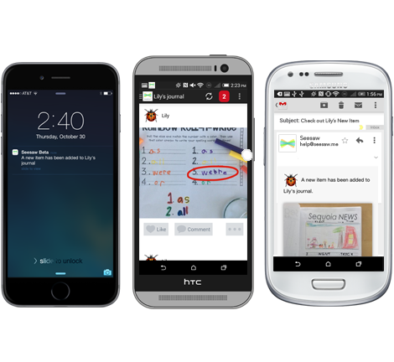
What is Seesaw?
A digital portfolio that collects students’ digital and physical work in one place. Everything is organized, making assessment and conferences easier!
A space that each student can own. Built-in tools make it easy for students to capture their learning, reflect, and develop new skills.
A parent communication tool that seamlessly shares what’s going on in your classroom and builds a strong school-home community.
MOST IMPORTANTLY:
An ONLINE digital portfolio that allows students to VIEW and COMMENT on each others posts that is SAFE
Not accessible to the public/web
Nothing can be posted without teacher vetting & approval
**DISCLAIMER: While this IS a CLOSED, PASSWORD PROTECTED site; it is OCSB policy to obtain parental permission for ANY student image, work, etc. be posted online. Please check to be sure forms are signed giving permission . ****
Watch the video to see how students describe Seesaw!
https://www.youtube.com/watch?v=LbADgksW2L8

Slide 11
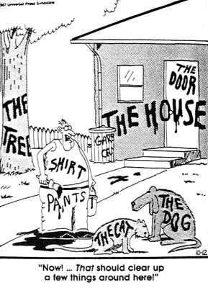
LET’S KEEP THIS SIMPLE...
GETTING STARTED:
Download SeeSaw, the learning journal app on android, idevice or go to https://web.seesaw.me/ or https://app.seesaw.me/

Slide 12
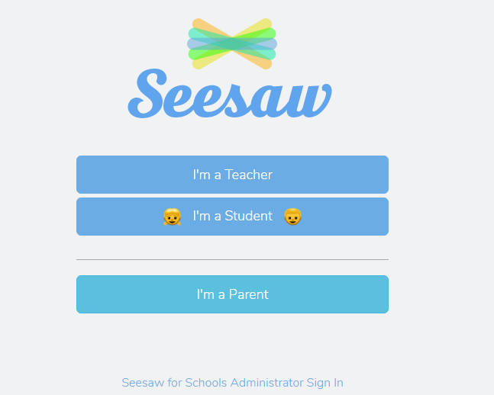
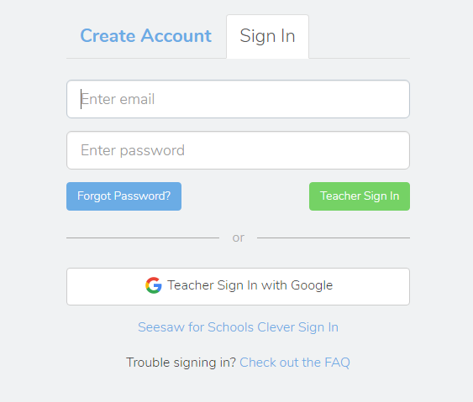
CREATING AN ACCOUNT IS AS EASY AS:
2 ...AND HERE
CLICK HERE...
3. ...THEN START CREATING YOUR CLASS!

Slide 13
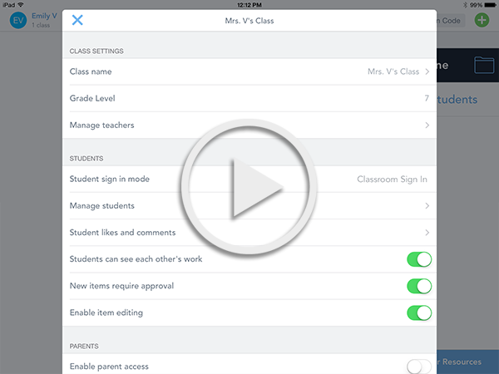
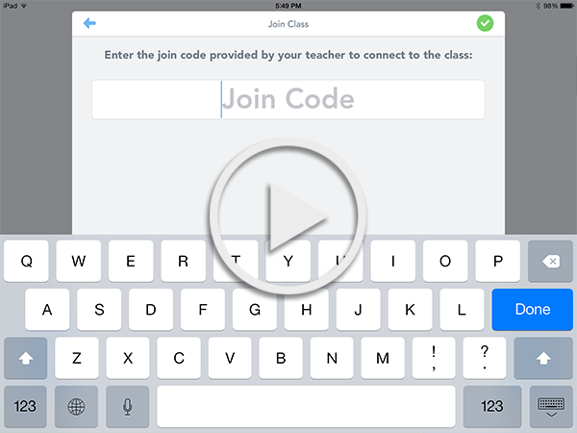
Class Setup and Class Settings Help
If you need help setting up your Seesaw class or changing class settings, use these resources.
Follow the Class Setup Checklist
Watch how to set up a Class Code Class video
Watch how to set up an Email Class video

Slide 14
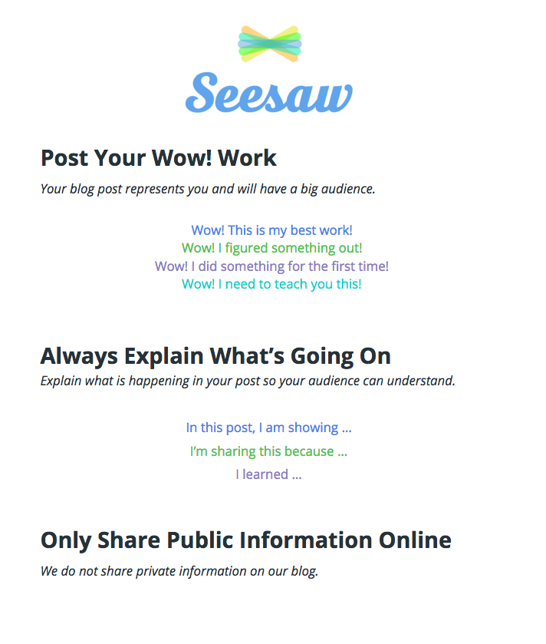
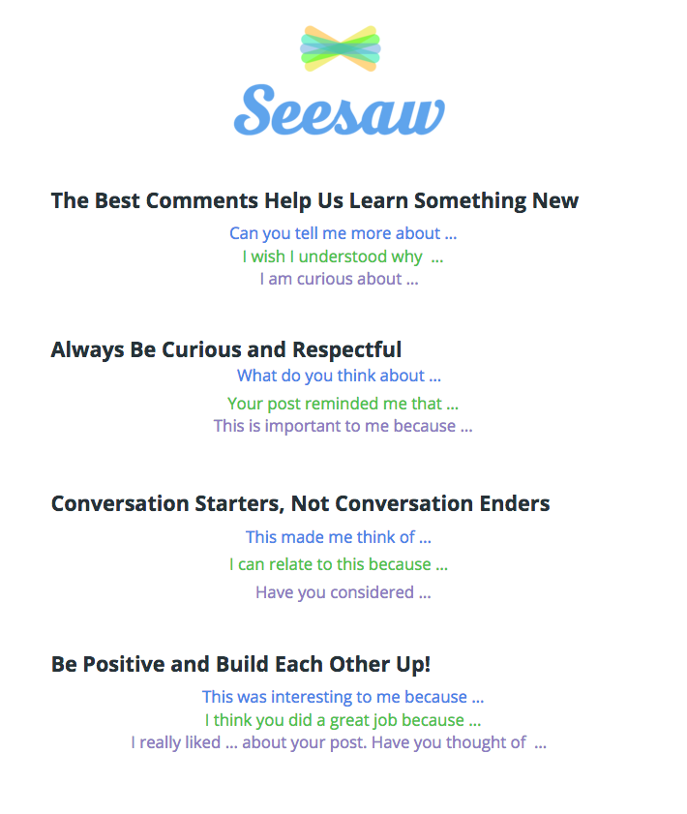
Tip: Digital Citizenship Resources
Print the Posters!
Use these guidelines to encourage great posts and comments!

Slide 15
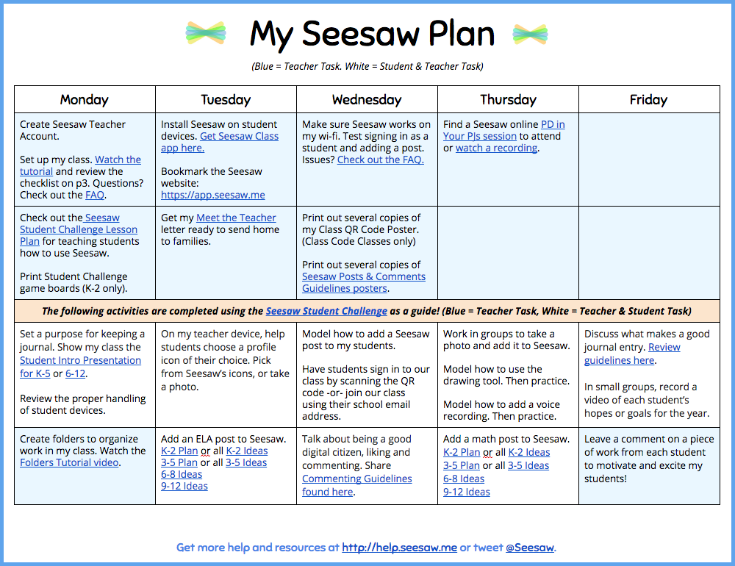
TEACHER ROLL OUT PLAN
Get the Plan!

Slide 16
...let’s look at the real action!

Slide 17
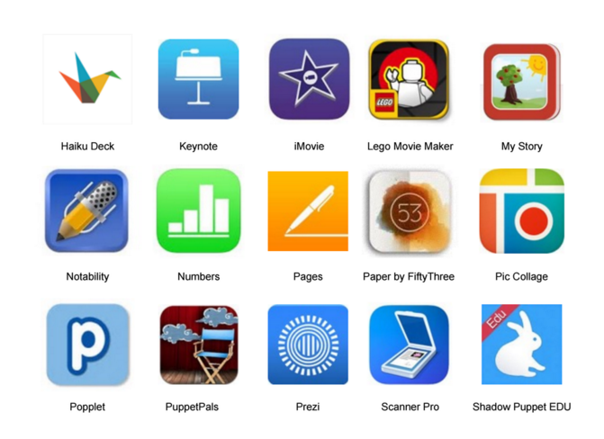
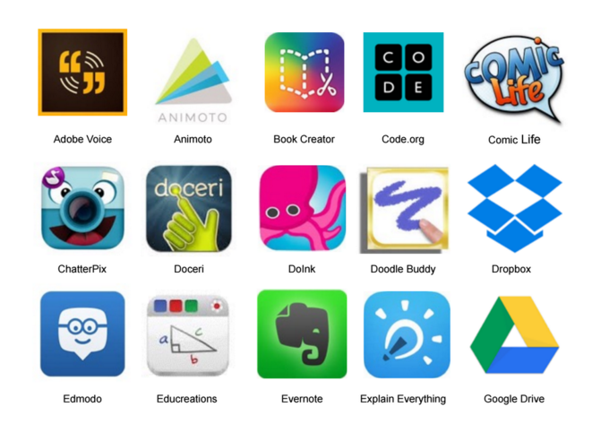
Last Time Saving Tips:
Save digital creations from many apps into Seesaw.
Photos, videos, links, PDFs—all go into Seesaw!
See a list compatible apps here

Slide 18
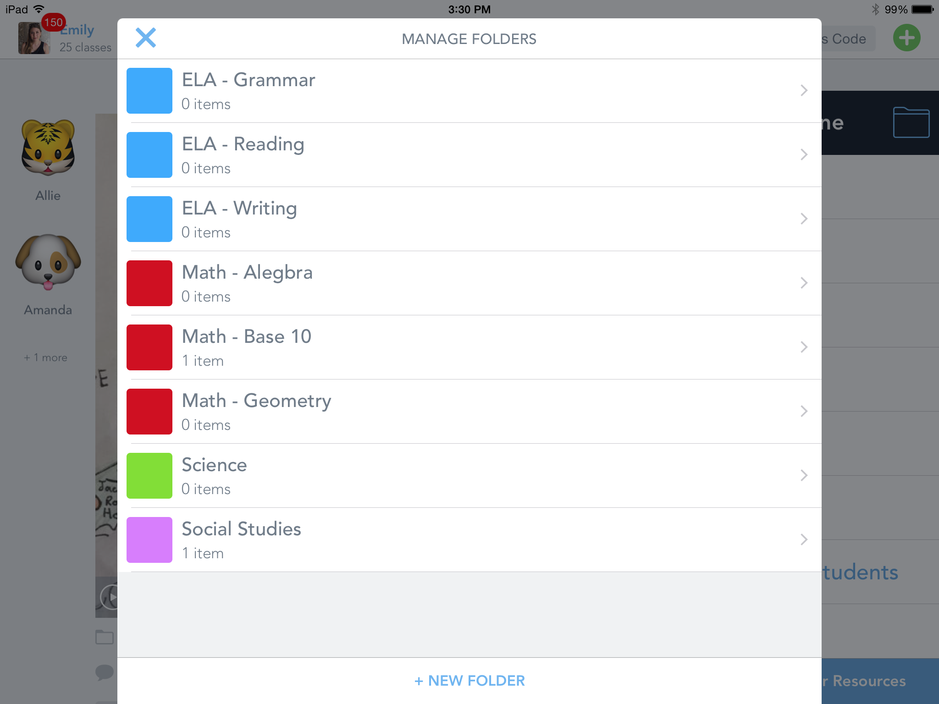
Use Folders to Organize Work
Watch the video to learn how to create and use folders!

Slide 19
FINAL THOUGHTS:
This is a definite learning experience for both myself and my students, but it’s really starting to be worth it.
Students now look to each other for help, inspiration and guidance - often from home!
They all find that the visual record of their development is especially effective for reflecting on their Creative Process
They don’t all like it!!
Go to help.seesaw.me for resources & contact me if you have any more questions!
Thank You!

