Slide 1
Quick and Easy Tech Tools for collecting assessment data
(product, observations and conversations)
http://bit.ly/2eJVV35

Slide 2
Plan for the workshop
Assessment basics/the padagogy wheel
Connecting with Google
Tools for assessing:
Conversations
Observations
Products

Slide 3
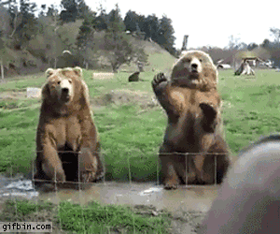
I’ll even show you how to do this :)
(Not wave like a bear, but embed these fun moving pictures into emails and documents)

Slide 4
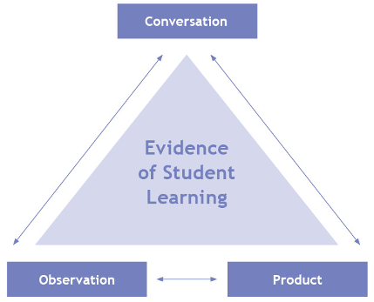
Why?
“Evidence of Student Achievement for Evaluation
Evidence of student achievement for evaluation is collected over time from three different sources – observations, conversations, and student products. Using multiple sources of evidence increases the reliability and validity of the evaluation of student learning.” Growing Success, p.39

Slide 5
Collecting Evidence of Learning
Conversation
What they are saying.
Slide borrowed from:
Jim Jamieson - YRDSB
small group instruction
1-on-1 conference
analyze student self-assessment
small group discussion
Google Doc revision history and comments
projects
assignments
notebooks
journals
tests, exams
rich performance tasks
demonstrations
essays
labs
website, video, blog
small group instruction
presentation
science being applied
music being played
work done in pairs
logs, notes, recordings
Google Doc revision history and comments
Triangulation of Data
Product
What they are representing.
Observation
What they are doing.
Notes:
Slide created by Jim Jamieson - YRDSB

Slide 6
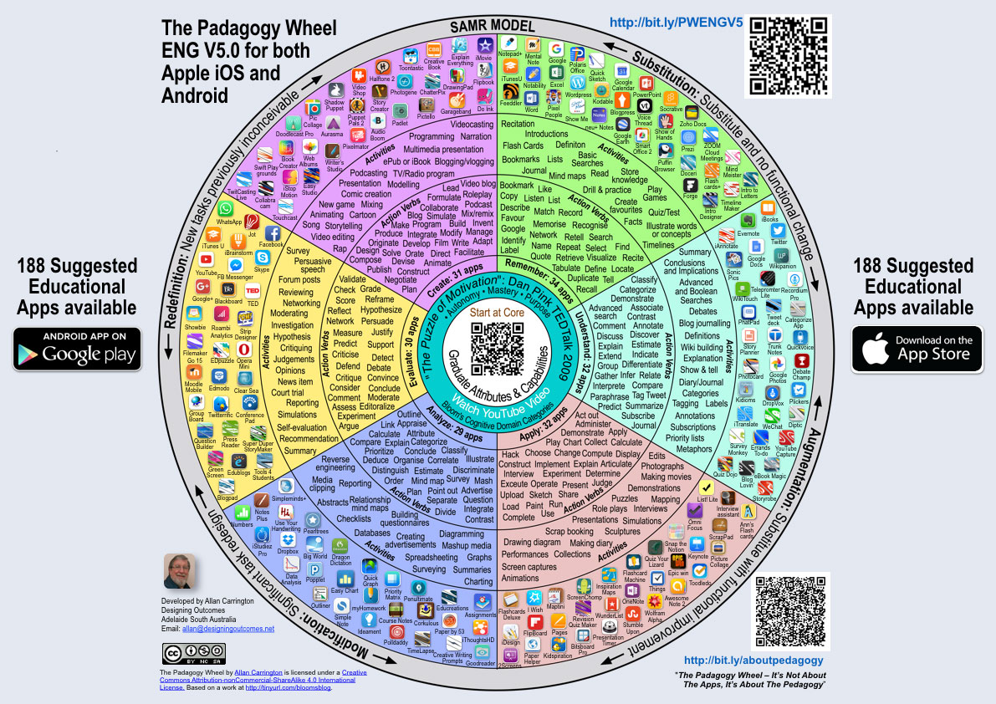
The Padagogy Wheel
Website to see it bigger
Click HERE to download your own copy → when you click on the icons it will take you to the Google Play store
Click HERE for Apple version

Slide 7
Create
Remember
Understand
Apply
Analyze
Evaluate

Slide 8
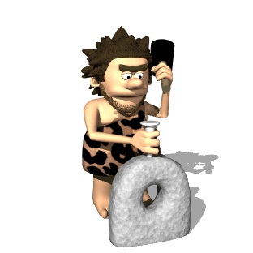
Deep Learning
When developing assessments → consider the 6 global competencies of deep learning. What are students getting out of the assessment? What skills are they learning or developing? Are you giving your students opportunities to practice these skills?
Critical thinking
Collaboration
Creativity
Communication
Citizenship
Character

Slide 9
Connecting with Google
Why make new usernames and passwords???
Click on the “Google” symbol to sign in with your @ocsb account
Works for students too! Super easy → no need to remember passwords, auto-connects to Drive with some programs

Slide 10
Assessment Tools for Conversations

Slide 11
Visual/Graphics Tools
Google Draw, Adobe Spark, Piktochart

Slide 12
What it is:
Web based tools that allow students to create posters, infographics, flow charts, etc.
Google Draw → part of your Google Suite host of tools, available to you and to your students through Google Drive
Adobe Spark → free, can connect through Google, allows you to create visually attractive posters, etc.
Piktochart → infogrpahic creator tool

Slide 13
How to use it:
Google Draw → collages, show me what you learned yesterday with pictures, posters
Adobe Spark → fancy posters, pretty slides, interactive “blog” style creations
Piktochart → teaching summary skills - students need to focus on what’s important (few words, lots of images)
Infographics are used on the OSSLT → show students how to read them and then have students create their own - reading and then summary skills (what’s the big idea?), students can then “read” each other
Math! Students can summarize numbers, stats, can include graphs, etc.

Slide 14
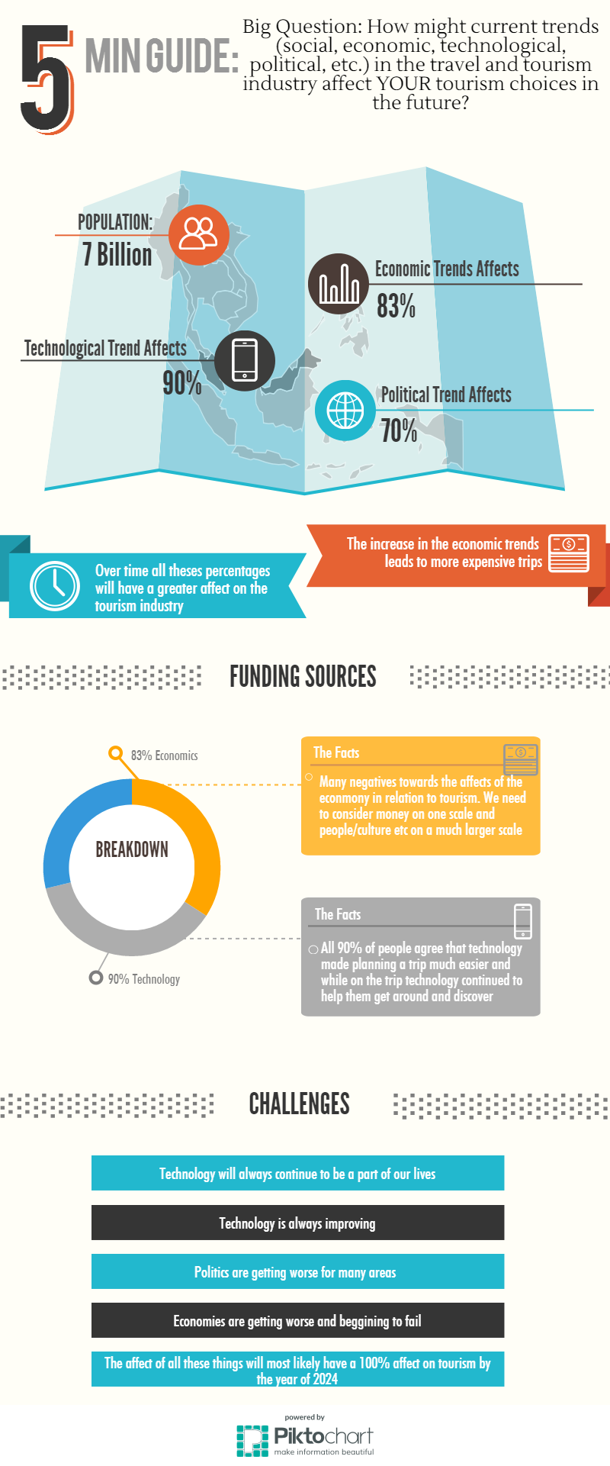
Adobe Spark Example

Slide 15
Screencasting
Screencast-o-matic, Screencastify

Slide 16
What it is:
Using your computer microphone to record your voice talking while showing something on your screen.
GREAT for capturing student voice → awesome with students who are weak writers
Practicing writing IS important, BUT we also need to be aware that we aren’t always assessing their ability TO write, but their ideas and understanding about a topic. Are their writing skills limiting their abilities in your class?

Slide 17
How to use it:

Slide 18
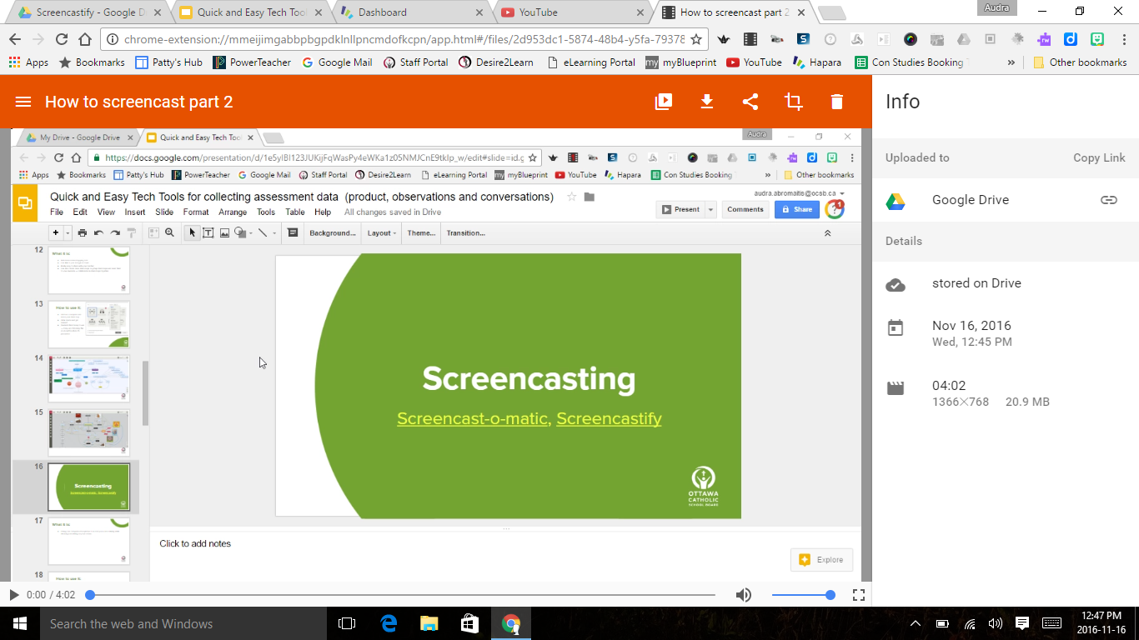

Slide 20
Mind Mapping
Mindomo

Slide 21
What it is:
Web based mind-mapping tool
Can link to your Google account
Really easy to share with your teacher
Can also create class mind maps or group mind maps and send them to your students → collaborate on mind maps together
Great for brainstorming, showing students how to make connections, exploring relationships between ideas, etc.

Slide 22
How to use it:
Choose a template and name your mind map
Click create and get started!
Students find it easy to use → many are choosing this as an option when it’s presented

Slide 23
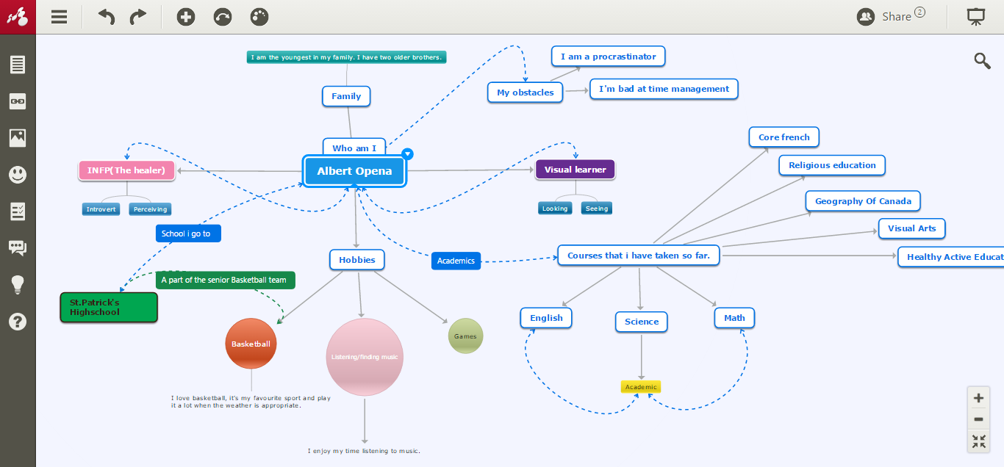

Slide 24
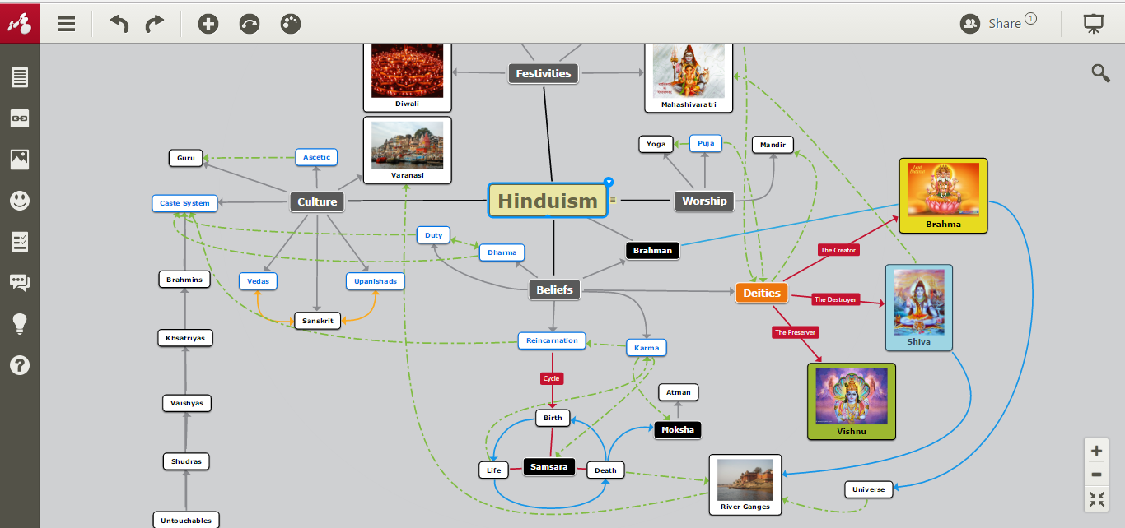

Slide 25
Assessment Tools for Observations

Slide 26
Google Forms
Forms

Slide 27
What it is:
Survey creator tool
Can use to collect evidence of student learning
Can use to evaluate students
Great for organizing evidence → generates a spreadsheet
Has a quiz feature now
Sample forms: (adapted from Jim Jamieson - YRDSB)
On the fly questions
Rubric
Ticket out the door

Slide 28
How to use it:
Access through Google Drive
New → more → Google Forms
Step by step instructions

Slide 29
Assessment Tools for Products

Slide 30
Want students to diversify?
Consider creating a choice board for your semester/term. Students can only use each option one time → forces them to try new things and explore other amazing tools where they can showcase their talents and strengths.
Prezi | Google Slides | Google Draw
Mindomo | PowToon | WeVideo
My Simple Show | Google Tour Builder | Written Report
Adobe Spark | Screencast | “Fake” instagram accounts or SnapChat Stories

Slide 31
Animated Video Makers
PowToon, MySimpleShow

Slide 32
What it is:
Video creation tools
Great for projects (because I’m so over Prezi)
Less text/more visuals
Students can be super creative
Warning! Don’t let students use the “Premium features” in PowToon → all kinds of problems. :)

Slide 33
How to use it:
How to video’s inside both programs
Link or access through Google account
Students are great at “figuring them out” → let them play, experiment, help each other out

Slide 34
Sample PowToon

Slide 35
Easy Bibliographies
EasyBib

Slide 36
What it is:
Web based bibliography tool (one of many)

Slide 37
How to use it:
In Google Docs..
Click “Add-Ons” → “Get Add-Ons”
Search for “EasyBib” → Click “Free”
To use it → Click on “Add-Ons” - EasyBibliography Creator - Manage Bibliography
BOOM! Wow how lucky are these kids these days?!?

Slide 38
Google Tour Builder
TourBuilder

Slide 39
What it is:
Google Maps + Google Slides mixed together
Create “tours” → great for projects
Still new so only one student can work on it (not collaborative… yet)
Can embed descriptions, visuals, video’s, etc. onto points

Slide 40
How to use it:
I went to an hour long session about this tool
Here are the slides → play with it and have some fun! :)

Slide 41
How to insert a GIF
Google Images → search tools → type → animated
Search for what you want (tiger)
Right click on GIF you want → copy image address
In your Google slide/doc/email, etc. → insert → image → by URL
Paste the image address here → it should show up
Click select and there it is!

Slide 42
Want to learn more?
G Suite Learning Centre → learn how to use all the Google Tools
Email me: audra.abromaitis@ocsb.ca
Twitter: @msaudraabro

